Slide 1

AOLME Curriculum SESSION 2
MATERIALS DEVELOPED BY THE AOLME PROJECT AT THE UNIVERSITY OF NEW MEXICO, PLEASE DO NOT COPY OR DISTRIBUTE ANY OF THESE COPYRIGHTED TASKS WITHOUT PROPER AUTHORIZATION OF PROJECT

Slide 2


Level 1
SESSION 1: Basic of Raspberry PI and Linux-(motivational overview of projects-images, ls, cd) SESSION 2: Introduction to Python Programming (print, algebra, strings, binary images) SESSION 3: Algorithms (for and while loops, range commands, if statements, inequalities) SESSION 4: The Coordinate Plane and Black & White Images in Python SESSION 5: Binary and Hexadecimal number systems SESSION 6: Images and Their Components (histograms) SESSION 7: Creation of Images and Video FINAL PROJECT: VIDEO

Slide 3
introduction to Python Programming
OBJECTIVES:
Apply basics of Python Programming.
Program basic operations and variables in Python.
Solve and create own operations, and arithmetic-algebraic expressions.
Program a number guessing game using Python.

Slide 4

Selected ACTIVITIES
1. Exploring Python Programming (print, strings, basic operations)
2. Programming Operations with Python (coordinates, linear equations, order of operations, and complex expressions)
3. Creating Your Guessing Game w/ Python (design, program, and share game by altering initial, base codes)

Slide 5
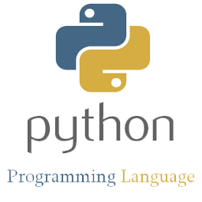
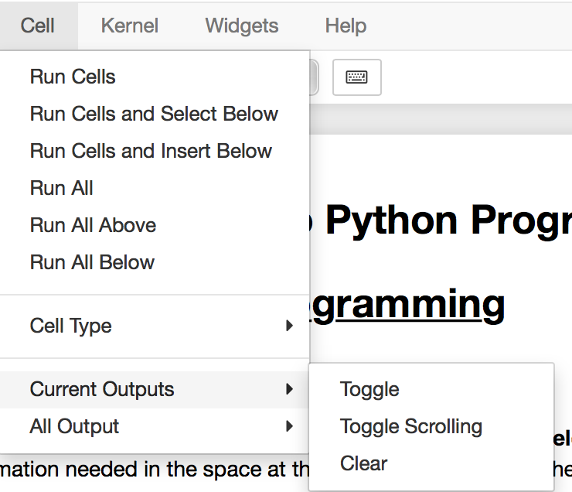
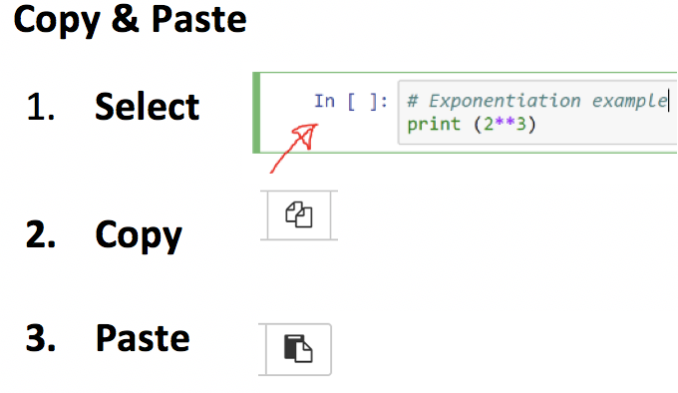
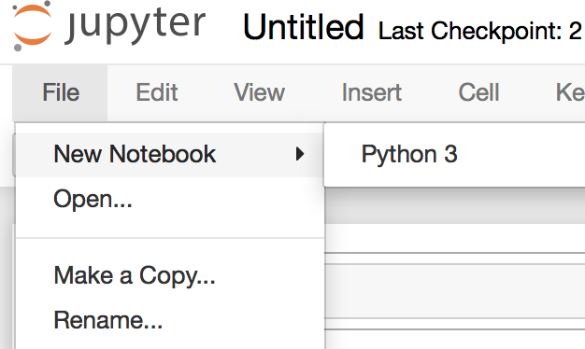

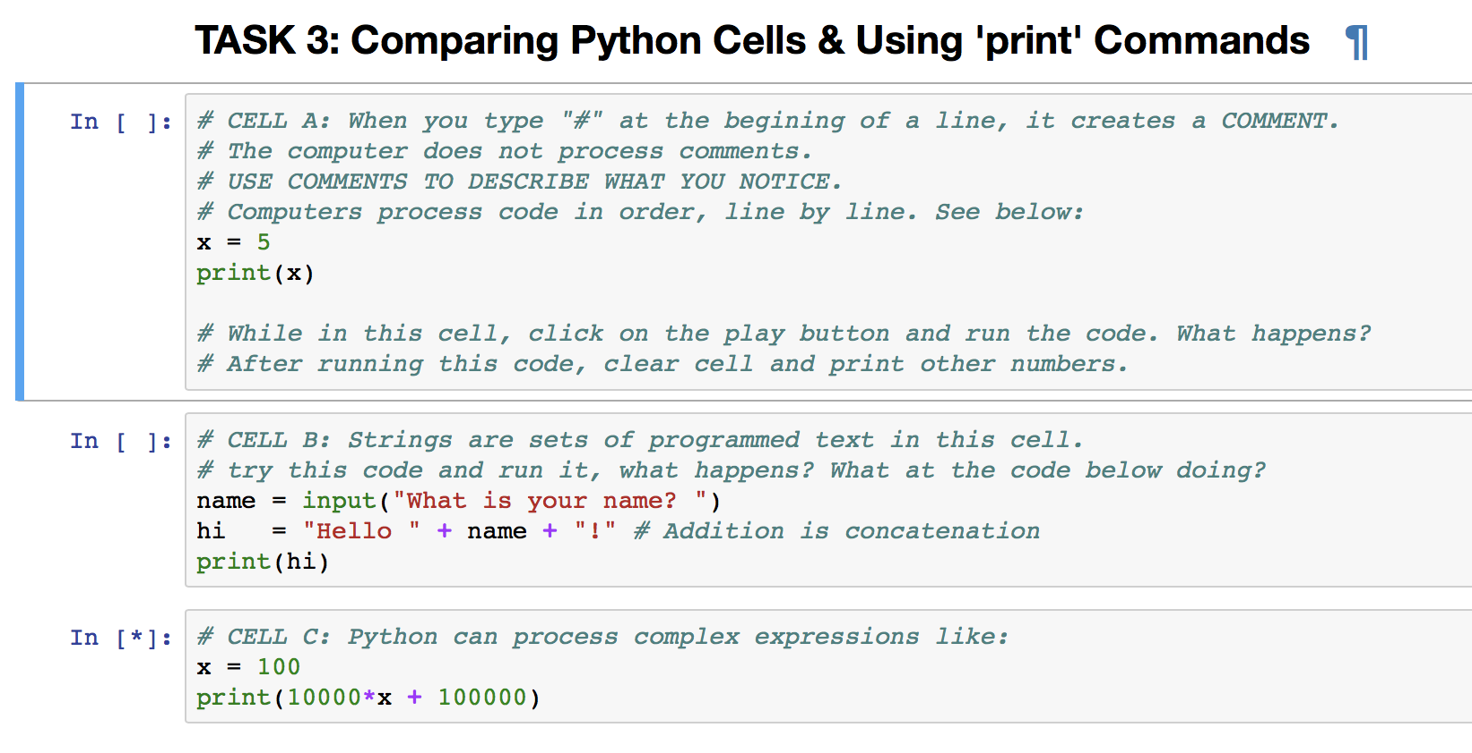

2.1. Exploring Programming with Python
1. Let’s practice programming with Python by using Jupyter. Access it by going to:
2. To play the Guessing Game: (a) open Session 2 file in Jupyter,
(b) select top cell with game code,
(c) click ‘run’
(d) enter data at bottom of cell
(e) take turns
(f) clear cell to enter new data
Open a new file. Navigate Jupyter by exploring what each taskbar icon does.
Don’t forget to save your work by clicking on this icon
Select cell to work on by clicking on it.
Follow these steps to clear result of cells
3. There are different kinds of cells in Jupyter. What do you notice?
4. Discuss & Create: Based on what you did in task 3, as a team complete the challenges in TASK 4 in Jupyter. This helps to learn how to program the guessing game.
Be creative and have fun.
Why does this cell have a blue frame?
These boxes are cells: what difference do you see between Python & Text cells?
Try these codes out. What does ‘print’ mean?
Have you played the guessing game before?
AOLME PROJECT - LEVEL 1- SESSION 2- 2018
MATERIALS DEVELOPED BY THE AOLME PROJECT AT THE UNIVERSITY OF NEW MEXICO, PLEASE DO NOT COPY OR DISTRIBUTE ANY OF THESE COPYRIGHTED TASKS WITHOUT PROPER AUTHORIZATION OF PROJECT
Notes:
Reduce number of codes P
Provide examples of images and how they were pixelated

Slide 6
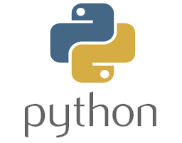
2.1. Exploring Programming with Python
Resources for the Activity
Recommended Steps for the Activity
Make sure the “Binary Image Generator” online is set in the binary (black and white) choice. Students have to set up the ‘size’ of the matrix. Maybe 10 by 10?
Have students think about how numbers and colors are related.
Let students have fun, play creating images.
Make sure students take turns using the generator and that others pay attention to what is going on on the generator.
Have students debrief what they learned by experimenting with the binary image generator and have them write notes in journal.
Activity Card
Folder: /pi/AOLME/Session 4/
the “Image Generator” online
Raspberry Pi and Monitor
Student journal
Activity 1 Goal: Apply basics of Python Programming.
AOLME PROJECT - LEVEL 1- SESSION 2- 2018
MATERIALS DEVELOPED BY THE AOLME PROJECT AT THE UNIVERSITY OF NEW MEXICO, PLEASE DO NOT COPY OR DISTRIBUTE ANY OF THESE COPYRIGHTED TASKS WITHOUT PROPER AUTHORIZATION OF PROJECT
Notes:
Reduce number of codes P
Provide examples of images and how they were pixelated

Slide 7
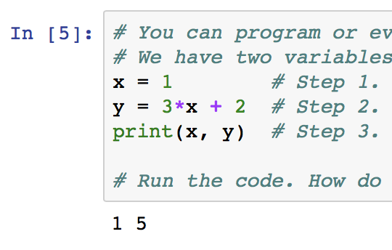


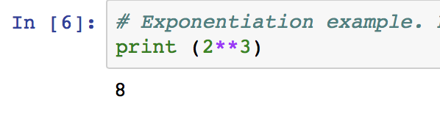
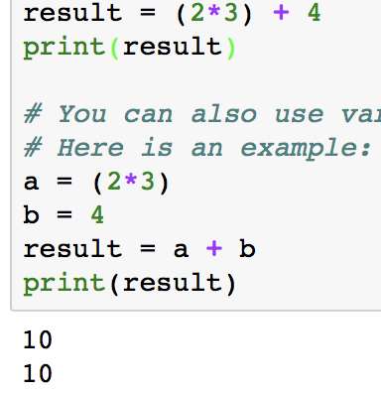
2.2. Programming Number Operations w/ Python
1. Let’s use Math and Algebra to program with Python.
2. In TASK 2 in Jupyter, program and operate equations.
What do we remember about linear equations?
Play w/ these equations. Come up with other values. What happens?
How are these numbers related to the codes above?
What variables do you see?
What’s a variable?
How are these ‘x’ and ‘y’ different from the ‘x’ and ‘y’ of an image coordinate?
3. What do you know about PEMDAS? How can order help?
4. In task 4, solve the equation by creating variables and using PEMDAS. How would you solve and group these numbers?
In Equations, we operate in this order:
P: Parenthesis.
E: Exponents.
MD: Multiplications and divisions from left to right.
AS: Additions and subtractions from left to right.
What do you think about doing Math with Python?
We’re almost ready to program the guessing game!
When running first cell in Task 3, why do you get two 10s? Change the variable values or operations to get different numbers.
AOLME PROJECT - LEVEL 1- SESSION 2- 2018
MATERIALS DEVELOPED BY THE AOLME PROJECT AT THE UNIVERSITY OF NEW MEXICO, PLEASE DO NOT COPY OR DISTRIBUTE ANY OF THESE COPYRIGHTED TASKS WITHOUT PROPER AUTHORIZATION OF PROJECT
Notes:
Reduce number of codes P
Provide examples of images and how they were pixelated

Slide 8
2.2. Programming Number Operations w/ Python
Resources for the Activity
Recommended steps for the Activity
Make sure that each student comes up with own image and encourage them to be creative and not worry about being perfect.
Model and practice with students how to name the coordinates. Emphasize the order of RC, rather than the other way around.
Discuss how the order of x and y (columns and row) is different from regular coordinates they learn at school.
Emphasize not showing images to partners before telling the coordinates to one another
As students are telling images to one another, if they go pixel by pixel, ask them whether there would be a quicker/ more efficient way to tell the coordinates.
Activity Card
Hand out with coordinate plane, 2 per team member
One thick pencil per team member
Activity 2 Goal 1: Program basic operations and variables in Python. Goal 2: Solve and create own operations, and arithmetic-algebraic expressions.
AOLME PROJECT - LEVEL 1- SESSION 2- 2018
MATERIALS DEVELOPED BY THE AOLME PROJECT AT THE UNIVERSITY OF NEW MEXICO, PLEASE DO NOT COPY OR DISTRIBUTE ANY OF THESE COPYRIGHTED TASKS WITHOUT PROPER AUTHORIZATION OF PROJECT
Notes:
Reduce number of codes P
Provide examples of images and how they were pixelated

Slide 9



2.3. Creating Your Number Guessing Game w/ Python
What makes this game work?
2. Inverse Operations: Multiplication is the inverse of division
Consider the following for a game:
Give me a number x
Multiply by 2. 2*x
Divide by 2. (2*x)/2=x
After these steps, we are back to x. We "divide by 2" because it is the inverse and it helps get rid of the result from "multiply by 2". Why do we want to get rid of the values we enter?
What’s the inverse operation of addition? Why?
The Number Guessing Game. To make the game work, we need to think about inverse operations.
Why do you think we need inverse operations in the number guessing game?
3. Think: What would this game do?
Give me a number. x
Add 3. x+3
Subtract 3. (x+3)-3=x
4. Design and program in your team a number guessing game. Take turns typing in the codes. Save your work. Use the code in cell 2.3. to start your game. Then, try to see if someone not from your group can play your game.
What would be some values or numbers to combine in the guessing game?
Use paper to check and predict whether your game will work.
Write in journal ideas you learned in Session 2 about Python programming.
AOLME PROJECT - LEVEL 1- SESSION 2- 2018
MATERIALS DEVELOPED BY THE AOLME PROJECT AT THE UNIVERSITY OF NEW MEXICO, PLEASE DO NOT COPY OR DISTRIBUTE ANY OF THESE COPYRIGHTED TASKS WITHOUT PROPER AUTHORIZATION OF PROJECT
Notes:
Reduce number of codes P
Provide examples of images and how they were pixelated

Slide 10
2.3. Creating Your # Guessing Game w/ Python
Resources for the Activity
Recommended steps for the Activity
Have students observe, think about, and play with the codes provided in the files. The goal of these files is to focus on experimenting to learn what each code or command does.
Talk about each line of code and how they are all related.
Prediction of images and black and white image should focus on link between numbers, pixels, and colors.
When modifying AOLME students’ image, suggest starting with small changes and running the program, so they become familiar with the code.
Let students have fun creating images and encourage creativity.
When creating team’s image, use team’s name as a prompt or initial ideas and have them take turns entering codes.
Have students debrief what they learned in the session and take notes in student journal.
Activity Card
Folder: /home/pi/AOLME/Session2 and file called “BW1.py”
File: /pi/AOLME/Session 4/BW-Image of an image previously done by AOLME students
File: /pi/AOLME/Session 4/Square. To practice making squares and ranges
Hand out with coordinate plane to design team’s image
Raspberry Pi kit
Student journal
Activity 3 Goal: Program a number guessing game using Python.
AOLME PROJECT - LEVEL 1- SESSION 2- 2018
MATERIALS DEVELOPED BY THE AOLME PROJECT AT THE UNIVERSITY OF NEW MEXICO, PLEASE DO NOT COPY OR DISTRIBUTE ANY OF THESE COPYRIGHTED TASKS WITHOUT PROPER AUTHORIZATION OF PROJECT

